Slide 1

Malignant Comments Classifier Prediction Project
by- Himanshu soni

Slide 2
PROBLEM STATEMENT
Online hate, described as abusive language, aggression, cyberbullying, hatefulness and many others has been identified as a major threat on online social media platforms. Social media platforms are the most prominent grounds for such toxic behaviour.
Our goal in this project is to build a prototype of online hate and abuse comment classifier which can used to classify hate and offensive comments so that it can be controlled and restricted from spreading hatred and cyberbullying.

Slide 3
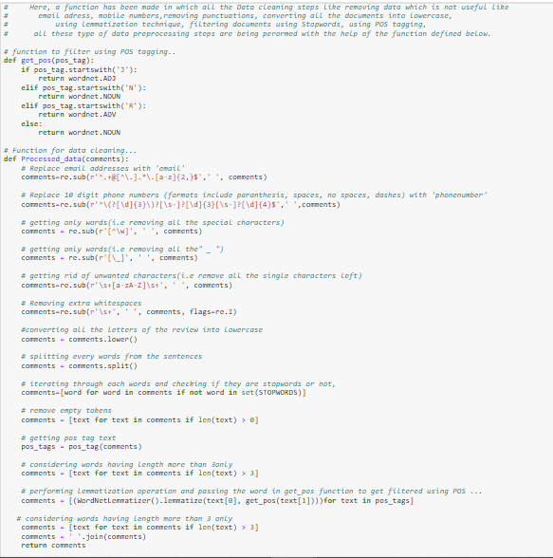
DATA PRE-PROCESSING
For Data pre-processing we did some data cleaning, where we used wordNet lemmatizer and porterStemmer to clean the words and removed special characters using Regexp Tokenizer and filter the words by removing stop words and then used lemmatizers and joined and return the filtered words.
Used TFIDF vectorizer to convert those text into vectors, and split the data and into test and train and trained various Machine learning algorithms.

Slide 4
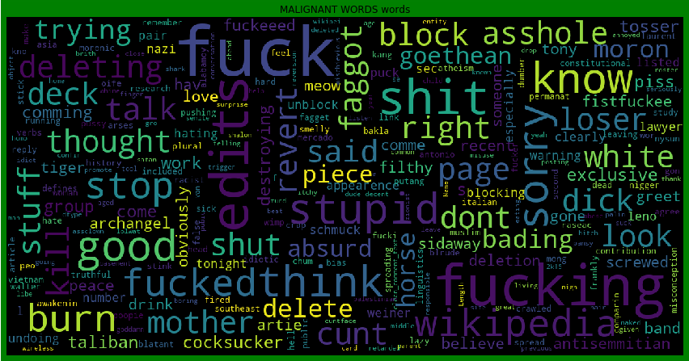
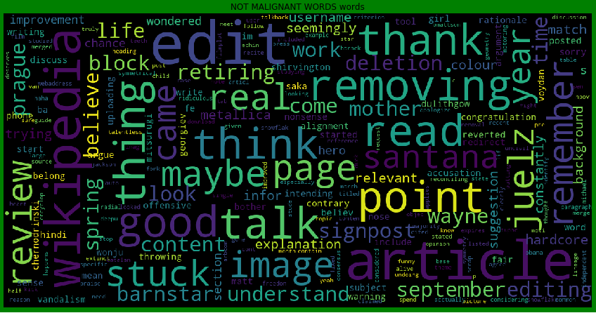
DATA INPUT- LOGIC-OUTPUT RELATIONSHIPS
Malignant WORDS
NOT Malignant WORDS
From the above we can see that most frequent words for both Malignant and Non Malignant category.

Slide 5
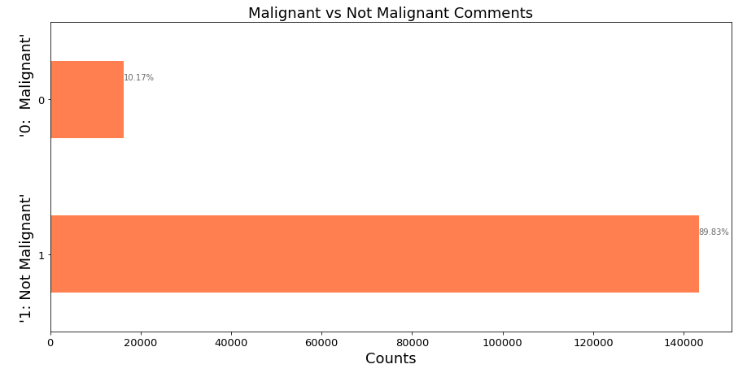
MODEL/S DEVELOPMENT AND EVALUATION

Slide 6
MODEL/S DEVELOPMENT AND EVALUATION
Testing of Identified Approaches (Algorithms)
LR=LogisticRegression()
MNB=MultinomialNB()
PAC=PassiveAggressiveClassifier()

Slide 7
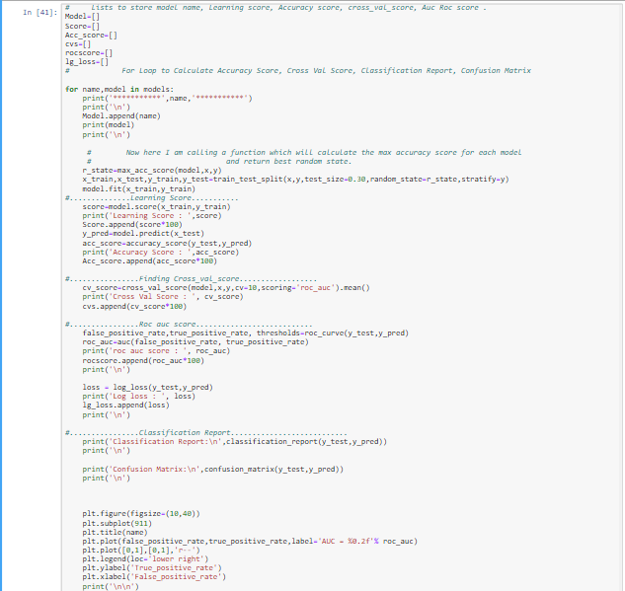
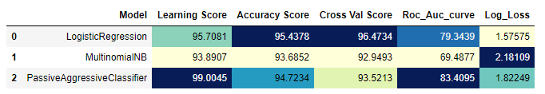
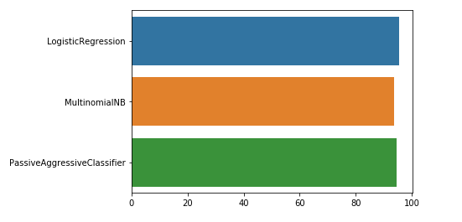
MODEL/S DEVELOPMENT AND EVALUATION
Run and Evaluated Some Selected models
Key Metrics for success in solving problem under consideration
After all this process conclusion is that Passive Aggressive Classifier is giving accuracy of 94.72%. So, now I am making a final model using Passive Aggressive Classifier.

Slide 8
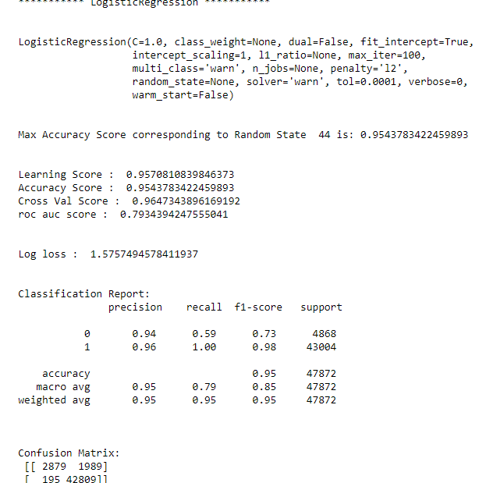
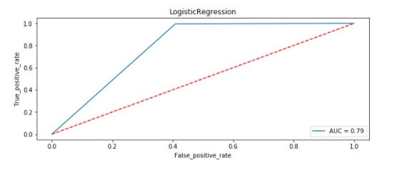
MODEL/S DEVELOPMENT AND EVALUATION
Logistic Regression Visualization:

Slide 9
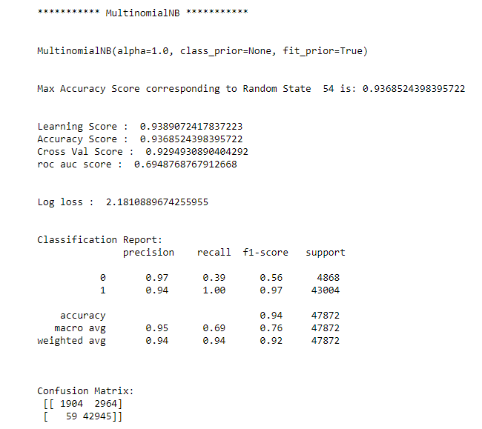
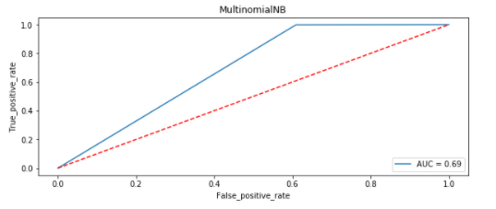
MODEL/S DEVELOPMENT AND EVALUATION
MultiNomial NB Visualization:

Slide 10
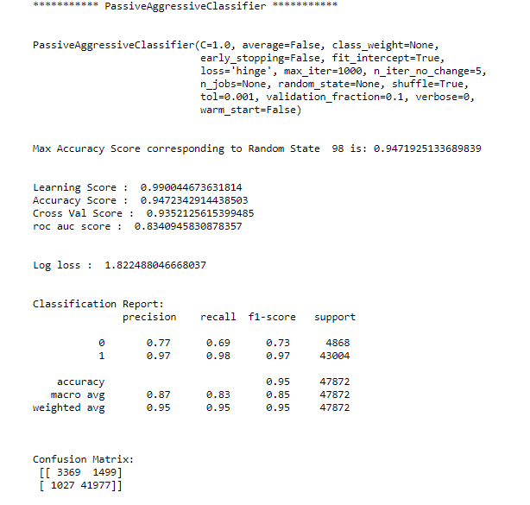
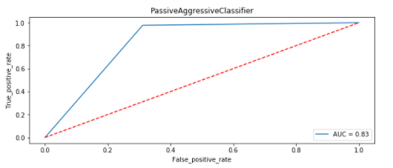
MODEL/S DEVELOPMENT AND EVALUATION
Passive Aggressive Classifier Visualization:

Slide 11
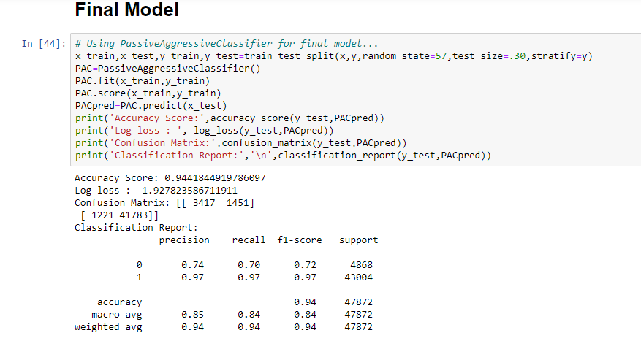
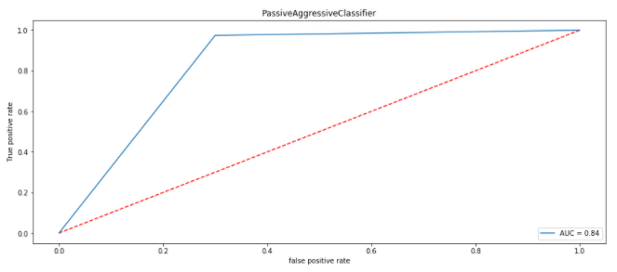
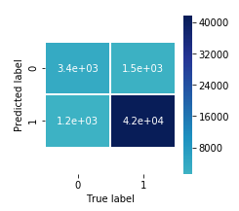
Final model
From the above visualization and matrices found that the Passive Aggressive Classifier performed the best AUC_ROC_SCORE i.e. 94.72%.

Slide 12
CONCLUSION
Key Findings and Conclusions of the Study
Online hate, described as abusive language, aggression, cyberbullying, hatefulness and many others has been identified as a major threat on online social media platforms. Social media platforms are the most prominent grounds for such toxic behaviour.
From the above analysis the below mentioned results were achieved which depicts the
chances and conditions of a comment being a hateful comment or a normal comment.
It is possible to classify the comments content into the required categories of Malignant and Non Malignant. However, using this kind of project an awareness can be created to know what is good and bad. It will help to stop spreading hatred among people.

